Slide 1
Buffalo
Originated in Asia ,which has spread to Africa and some European countries and south of American countries due to appropriate environmental condition for this animal, and this known as the water buffalo domesticated and buffalo is known an essential source in the agriculture economy for more than (26) countries of the world ,including China, Philippines ,and the group countries of Indochina, Malaysia ,India , Pakistan Egypt and Iraq .

Slide 2
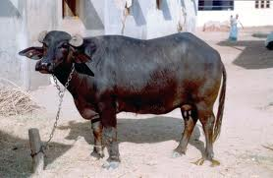
Buffalo
Originated in Asia ,which has spread to Africa and some European countries and south of American countries due to appropriate environmental condition for this animal, and this known as the water buffalo domesticated and buffalo is known an essential source in the agriculture economy for more than (26) countries of the world ,including China, Philippines ,and the group countries of Indochina, Malaysia ,India , Pakistan Egypt and Iraq

Slide 4
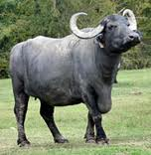

Slide 5
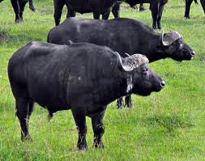

Slide 6
Type of Buffalo
There are two types of Buffalo they are
1-Swamp buffalo
This type prevalent and widespread in eastern countries especially the northern East part of Asia and in spite of the existence of variation in color and size , the Breeds are located did not differentiate into distinct types and known this kind in the Philippines(carabo),while the same called in Malaysia (Kerbao)

Slide 7
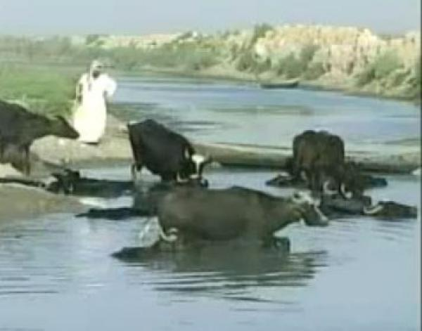
Type of Buffalo
There are two types of Buffalo they are
1-Swamp buffalo
This type prevalent and widespread in eastern countries especially the northern East part of Asia and in spite of the existence of variation in color and size , the Breeds are located did not differentiate into distinct types and known this kind in the Philippines(carabo),while the same called in Malaysia (Kerbao)

Slide 8
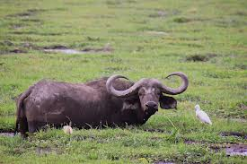

Slide 9
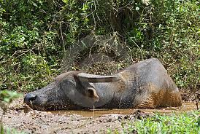

Slide 10
2-River Buffalo
River buffalo include are numerous type and exist in India ,Pakistan and many other countries and the general qualities of buffalo need to the water and this phenomenon led to the consideration buffalo animal ( a semi-aquatic animal),the buffalo found of swimming and in particular during the period of hot .

Slide 11
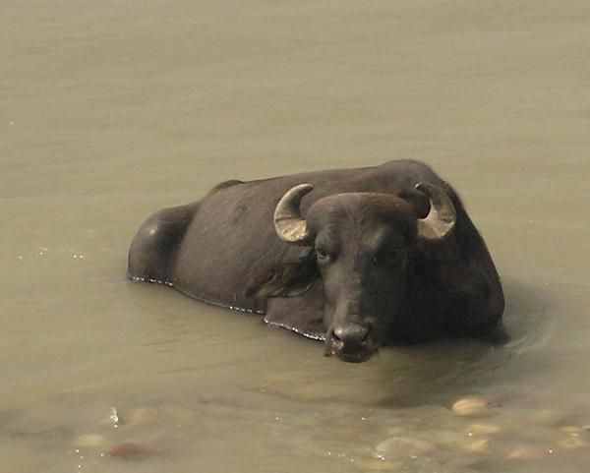

Slide 12
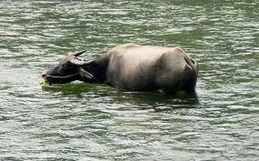

Slide 13
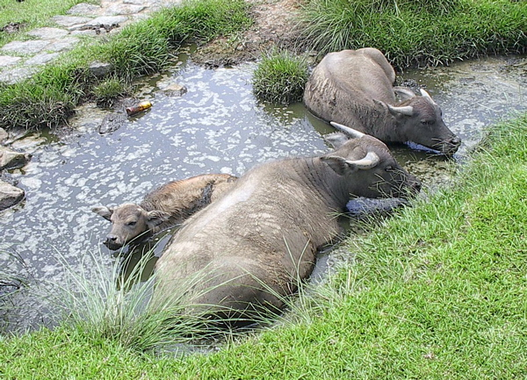

Slide 14
x-Buffalos active at night in grazing and swimming as well as to carry out and movement as well as mating .
x-His life long and buffalo that life given the necessary attention has to keep the continuity of economic in milk yield and work until (15)years .
x-The buffalo can work to stay until the age of (20)years and some of them keep up to (40)years.

Slide 15
The formal qualities of buffalo
1-Buffalo approximate weight range (230-1000)kg,in the Philippine the buffalo weight from (270-400)kg while in Toyland reach (900)kg.
2-The common color of buffalo are Grey and Black some time dark brown .
3-The river buffalo characterized by Grey color and the swamp buffalo characterized by grey color at first age then take to dark gradually to blue or black and no relationship between the color and the reproductive as well as the ability to hot environmental
4-The buffalo have long horn which different in shape and size

Slide 16
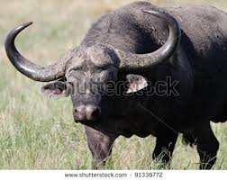

Slide 17
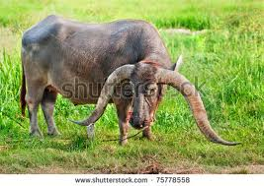

Slide 18
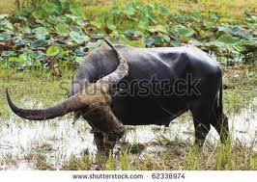

Slide 19
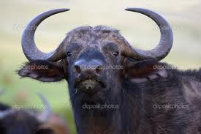

Slide 20
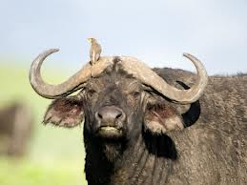

Slide 21
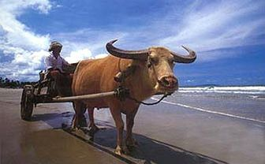

Slide 22
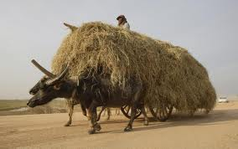

Slide 23
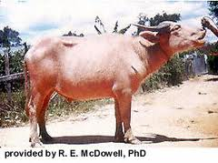

Slide 24
The productive qualities of buffalo
1-The buffalo can production of milk and meat beside the work.
2-The fat % in buffalo milk from (7,5-15).
3-Medium production of milk daily from (2,25-4,4)litter while female which specific for production milk reach daily (18) litter.
4-The period of milk production extended about (281)days.

Slide 25
Reproductive of buffalo
1-The maturity of male and female at age (12)month.
2-The estrus cycle each (21)days and extended for few hours to (12)hours
3-The first birth of female at age (2,5)years
4-Midum birth (2) each (3)years .
5-The gestation period of buffalo is(316)days.
6-The male can use for production in the second year of age

Slide 26
The Iraqi Buffalo
1-The buffalo in Iraq divided into two type
a-swamp buffalo b- Riverbanks and cities buffalo 2-Riverbanks and cities buffalo larger than the swamp type in size and in production of milk due to good care and feed. 3-The number of buffalo may reach to (195000)heads .
4-The buffalo in Iraq may consider the source of milk production .
5-Most of his preparation in the Central Region, where a population of buffalo (140,000) than about (68000) in Baghdad followed by the southern region, which has a population of buffalo about (47000) head

Slide 28
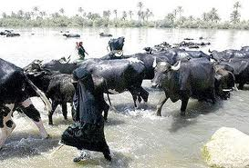

Slide 29
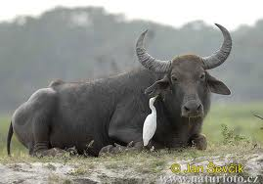

Slide 30
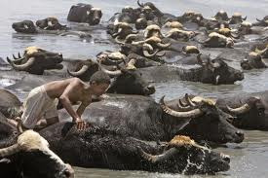

Slide 31
